Slide 1



X
KIMIA FARMA BUSINESS PERFORMANCE ANALYSIS
2020-2023
Kimia Farma - Big Data Analytics
Presented by
Lailatul Chairul Nisa

Slide 2





Insert your photo here
Lailatul Chairul Nisa
Data Enthusiast
A fresh graduate in Mathematics with strong analytical and interpersonal skills, having a strong interest in data processing and risk analysis. I have followed courses in this field to support my career development and have been supported by internship experience in data entry at PDAM Surakarta, focusing on data entry, data sorting, and making data easy to understand. Additionally, I have also had experience as a freelancer in event management for one year, developing communication skills, decision-making abilities, time management, and organizational skills.
Surakarta
nisalailatul224@gmail.com
Lailatul Chairul Nisa

Slide 3

About Company
Kimia Farma is a leading pharmaceutical company in Indonesia, established in 1960. It is a state-owned enterprise that focuses on the production and distribution of pharmaceutical products, including generic and branded medicines. Kimia Farma operates under the Ministry of Health of the Republic of Indonesia and is responsible for ensuring the availability of essential medicines in the country.

Slide 4


Project Portfolio
As a Big Data Analyst Intern at Kimia Farma, I was tasked with analyzing the company's business performance from 2020 to 2023. Equipped with raw data, I performed data cleaning, transforming, warehousing, and created a datamart, specifically Table Analysis, which contains final sales data using Google BigQuery to obtain organized and structured data for easy retrieval and analysis. Following this, I visualized the data using Looker Data Studio into an interactive and easy-to-understand sales report, enabling the company to make data-driven decisions.

Slide 5
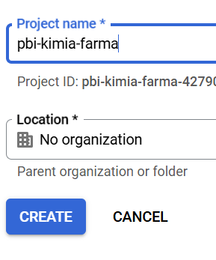

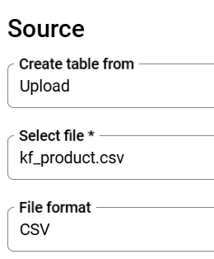

Importing Dataset to BigQuery
Upload the file you already have.
The first step is to create a new project.
Click Add to import raw data
Then give it a name according to your needs, and click CREATE.

Slide 6
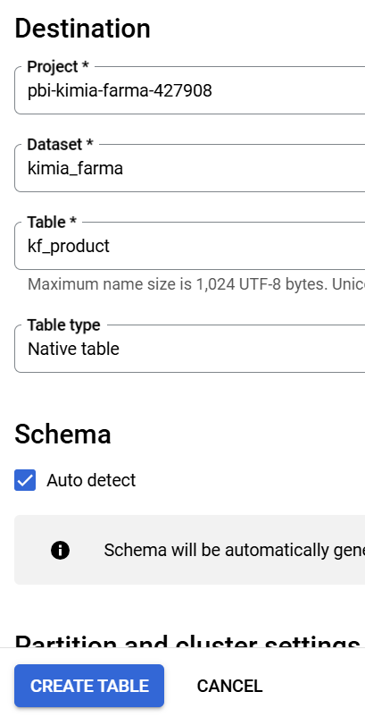
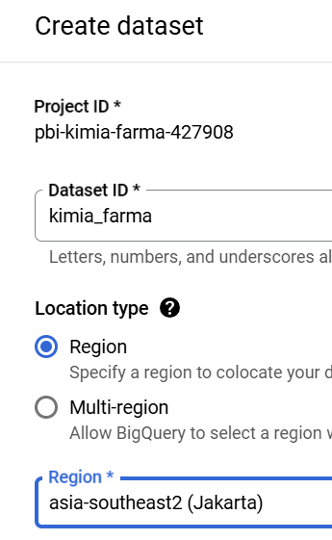
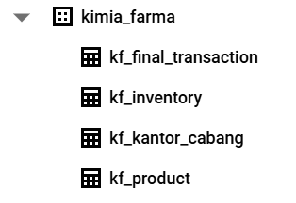
Importing Dataset to BigQuery
Name the Dataset and select Region, then choose asia-southeast2 (Jakarta).
Select the desired dataset. Give a name to the table
Check Auto Detect for schema creation. And create the table. If none exist, then create a new dataset.
Perform the same steps for all the datasets required.

Slide 7
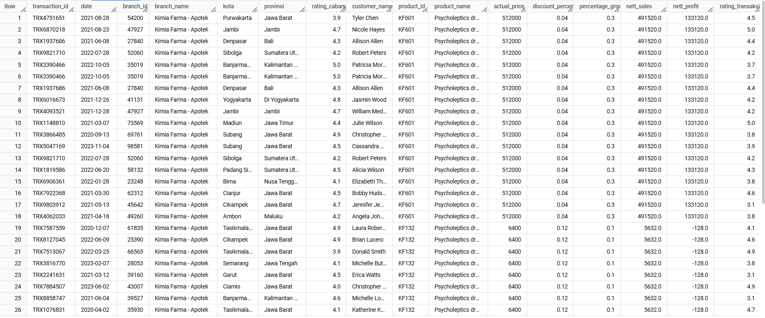
Tabel Analisa
This query creates a new table named `tabel_analisis ` that combines ` kf_final_transaction ` with ` kf_kantor_cabang ` and ` kf_inventory ` based on ` branch_id ` and ` product_id `, and calculates the ` nett_sales ` and ` nett_profit ` values for each transaction.

Slide 8
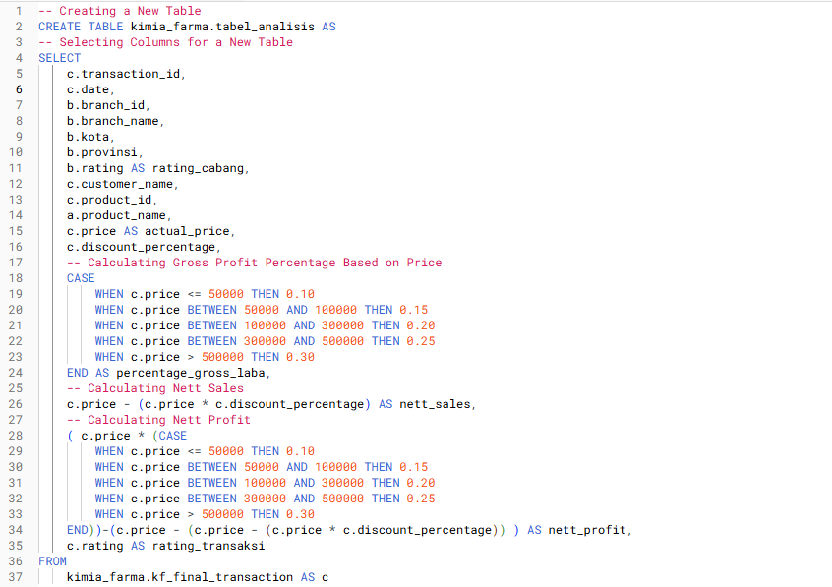
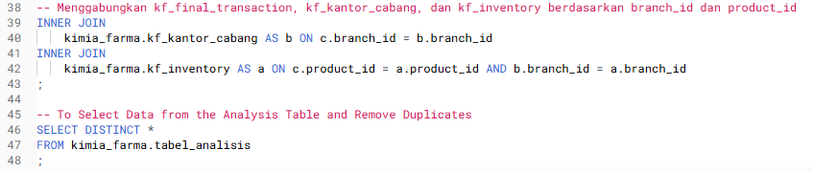
BigQuery Syntax
After successfully importing the dataset, a new datamart, specifically the `tabel_analisis `, will be created using the following SQL query syntax.

Slide 9
Dashboard Performance Analytics
The final result of this project is to create a Kimia Farma Business Performance Analysis dashboard for the years 2020-2023 using Google Looker Studio based on the analysis table previously created in BigQuery. This dashboard displays several analyses, including:
Summary Dashboard
Yearly Revenue Comparison
Top 10 Total Transactions by Province
Top 10 Nett Sales by Province
Top 5 Branches with Highest Rating, but Lowest Transaction Rating
Indonesia’s Geo Map for Total Profit by Province
Analysis of the Influence of Discounts on Transaction Volume and Profit

Slide 10
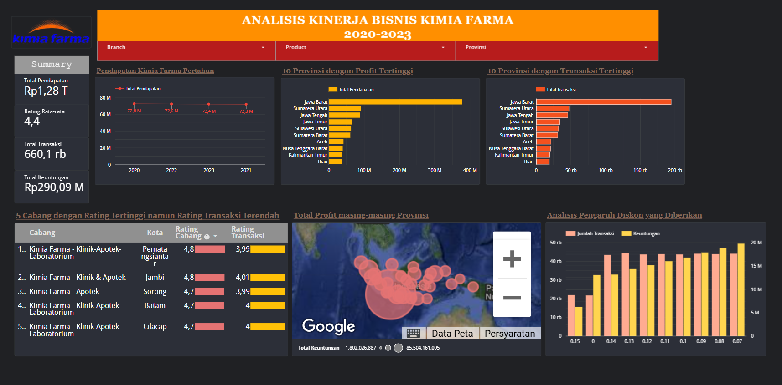
Dashboard Performance Analytics

Slide 11
Dashboard Performance Analytics
Income of Kimia Farma tends to be stable every year but experiences a slight decline. Therefore, a more in-depth analysis can be conducted on the factors that may cause the decline to significantly increase sales.
West Java Province holds the top position for the category of provinces with the highest profit and transactions. A suitable strategy needs to be implemented to maintain this position, including: increasing promotions for the most popular and market-demanding products and developing branch infrastructure, developing other provincial by implementing the same strategy used in the Jawa Barat branch.
The branch with the highest branch rating but relatively low transaction indicates that although customers are satisfied with the service or products, the transaction volume is still not optimal. A cause analysis can be conducted through : conducting customer surveys and increasing promotions by offering discounts and special offers.
Large discounts often attract many consumers and can be seen from the bar chart analysis of the influence of discounts. With many consumers, the profit obtained will also increase. However, it is necessary to remain cautious and ensure that the calculations still provide a profit.
4
1
3
2

Slide 12
Dashboard Performance Analytics
In summary, the analysis highlights the importance of strategic planning to maintain and improve the performance of Kimia Farma, particularly in terms of customer service, product promotions, and branch infrastructure development. The company must also be mindful of the impact of large discounts on profit and ensure that such strategies are implemented effectively to achieve significant sales growth.
More detail : you can check my repository

Slide 13
Thank You
X

